Slide 1
Canada’s COVID-19 Response and Immunization Plan: Saving Lives and Livelihoods
Canadian Dental Association - Presidents and CEOs Meeting
March 16, 2021
Howard Njoo MD, MHSc, FRCPC
Deputy Chief Public Health Officer
Interim Vice-President, Infectious Disease Prevention and Control Branch
Public Health Agency of Canada

Slide 2
Public Health Emergency Preparedness and Response in Canada
Canada’s COVID-19 Response and Immunization Plan: Saving Lives and Livelihoods
Shared responsibility
Multiple jurisdictions
Provincial/territorial role
Health care and public health service delivery
Federal role
International liaison; travel and border measures; health care and public health service delivery for certain groups
Collaboration and coordination
Federal, provincial and territorial governments work together on emergency preparedness and response to ensure coordinated efforts

Slide 3
Key Public Health Functions at the Federal Level
Canada’s COVID-19 Response and Immunization Plan: Saving Lives and Livelihoods
Surveillance
Knowledge broker
Convenor/facilitator
Public health capacity building and surge support
Laboratory science leadership
Regulatory responsibilities
International engagement
National/international communication

Slide 4
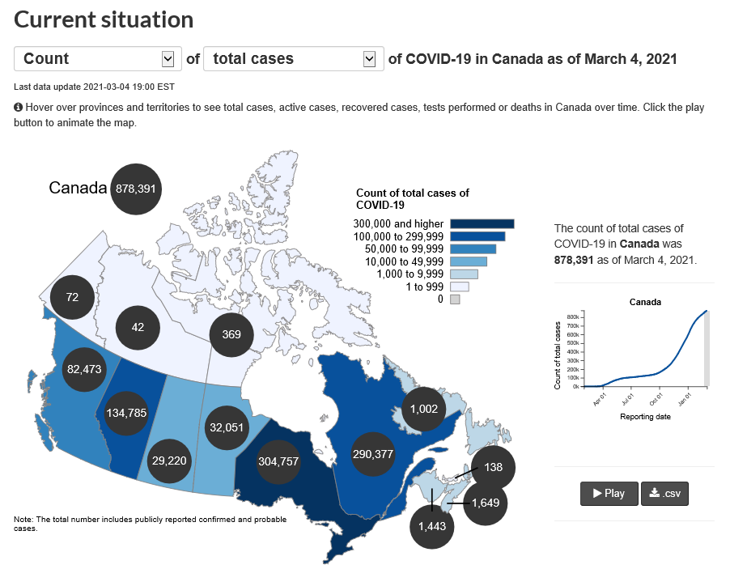
Surveillance
Canada’s COVID-19 Response and Immunization Plan: Saving Lives and Livelihoods
COVID-19 is a nationally notifiable communicable disease in Canada
Provincial/Territorial public health authorities are required to report confirmed and probable cases of COVID-19 nationally to PHAC
PHAC has been regularly producing national surveillance reports

Slide 5
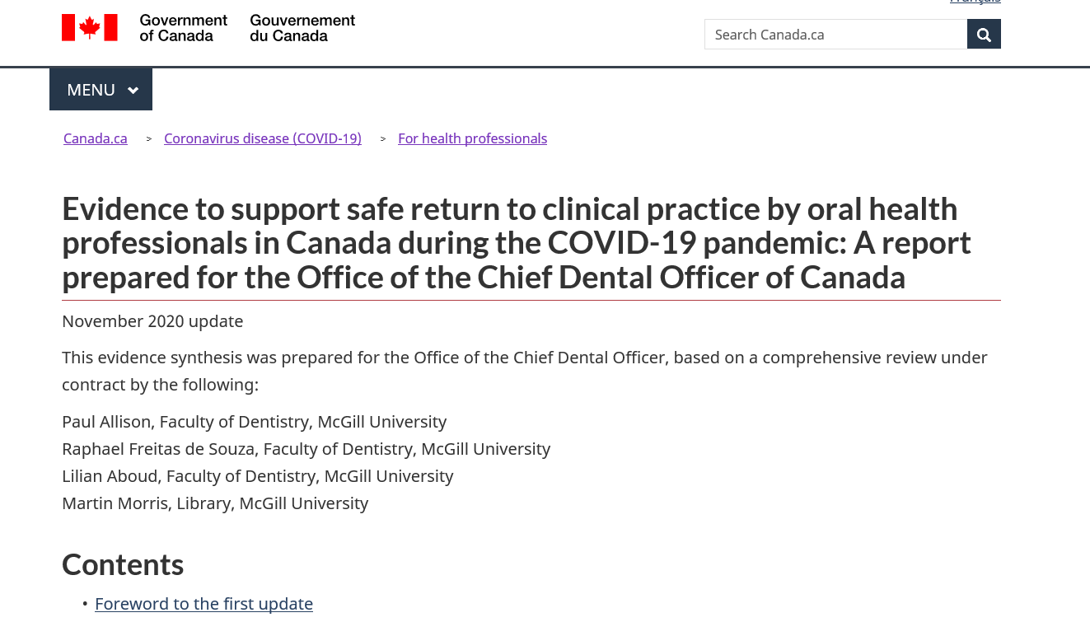
Knowledge Broker – Guidance documents
Canada’s COVID-19 Response and Immunization Plan: Saving Lives and Livelihoods
PHAC develops guidance documents to help guide policy makers and public health professionals when making decisions

Slide 6
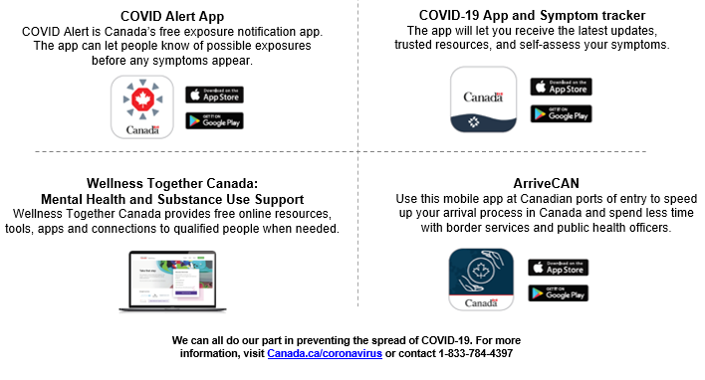
Pandemic Communication/Public Education and Digital Tools
Canada’s COVID-19 Response and Immunization Plan: Saving Lives and Livelihoods

Slide 7
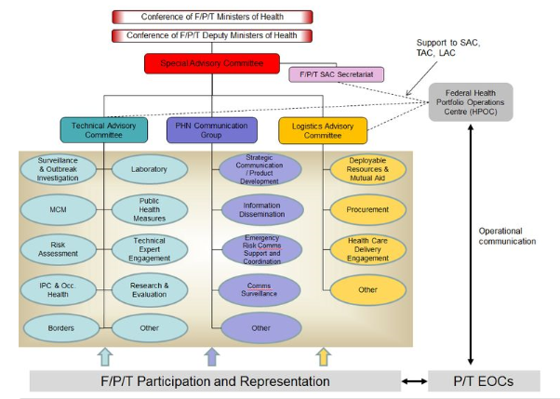
Convenor/Facilitator
Canada’s COVID-19 Response and Immunization Plan: Saving Lives and Livelihoods

Slide 8
Surge Capacity Support
Canada’s COVID-19 Response and Immunization Plan: Saving Lives and Livelihoods
Protecting Canadians from COVID-19 is the Government’s top priority, and PHAC will continue to be at the centre of the Government’s response to the pandemic
To date, the federal government and PHAC have provided:
Federally designated quarantine facilities
Epidemiological, nursing, and other professional support
Personal Protective Equipment (PPE)
Medical equipment/Laboratory supplies
Testing resources

Slide 9
Laboratory Science Leadership
Canada’s COVID-19 Response and Immunization Plan: Saving Lives and Livelihoods
NML has worked closely with provinces and territories through the Canadian Public Health Laboratory Network to advance testing capacity in Canada
NML scientists continue to investigate novel technologies to detect COVID-19, which can potentially enhance access to testing and increase ease of collection

Slide 10
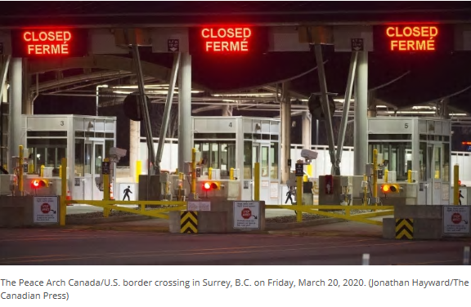
Regulatory Responsibilities
Canada’s COVID-19 Response and Immunization Plan: Saving Lives and Livelihoods
Unprecedented public health measures in this realm have taken place under COVID-19, such as border closures
Since May 2020, the Public Health Agency of Canada, under the Quarantine Act, has gradually increased its presence at key high-volume ports of entry across Canada, including land borders
Emergency measures to require travelers entering Canada to quarantine have been implemented

Slide 11
International Engagement
Canada’s COVID-19 Response and Immunization Plan: Saving Lives and Livelihoods
A global crisis requires a global response
The Public Health Agency of Canada is working closely with partners domestically and around the world, including the World Health Organization (WHO), to respond to this outbreak and provide guidance for public health professionals, health care providers and all Canadians

Slide 12
COVID-19 has had Inequitable Impacts
Canada’s COVID-19 Response and Immunization Plan: Saving Lives and Livelihoods
Occupational factors (e.g., ability to work from home, paid sick leave, job security, child care)
Living conditions (e.g., neighborhood characteristics, crowded housing)
Differential exposure
Biological factors (e.g., age, underlying health issues such as heart disease or diabetes)
Health behaviours (e.g., nutrition, physical activity, substance use, ability to comply with public health guidance)
Differential susceptibility
Access to and quality of health care
Financial and logistical barriers (e.g., transportation, language)
Previous discrimination by the healthcare system
Differential treatment
The Chief Public Health Officer of Canada’s Report on the State of Public Health in Canada 2020

Slide 13
New COVID-19 Variants: Background
Canada’s COVID-19 Response and Immunization Plan: Saving Lives and Livelihoods
Several COVID-19 variants of concern have emerged internationally.
The Public Health Agency of Canada (PHAC) is aware of three variants of concern present in Canada:
B.1.1.7 variant (first identified in the United Kingdom)
B.1.351 variant (first identified in South Africa)
P.1 variant (first identified in Brazil)
Additional variants being monitored include:
Potential US variant(s) being carefully watched: California L452R: potentially associated with higher transmissibility
Nigerian (P681H)
Uganda (HV 69-70 DEL)
Germany (first reported on January 18, 2021)
Source: SAC Feb 2 Reporting of COVID-19 VOCs

Slide 14
What do Variants mean for COVID-19 in Canada?
Canada’s COVID-19 Response and Immunization Plan: Saving Lives and Livelihoods
Emergence of new variants better adapted to human-to-human transmission is expected
Variants of concern (VOCs) are more transmissible, may be more virulent, may evade vaccinal resistance
There are five important implications for Canada:
1. As with all strains, spread of VOCs is facilitated by weak public health measures
2. More transmissible strains are more difficult to control – stronger public health measures are needed
3. When we open up again without controlling the epidemic, VOCs will have spread much wider in the community than the earlier strains before we know it
4. It is imperative that in each province/territory, closures are maintained until case incidence is very low before re-opening
5. If testing and tracing are not in place sufficiently to control spread, closures may need to be maintained until vaccine rollout is more complete

Slide 15
Variants of Concern – What Canada is doing
Canada’s COVID-19 Response and Immunization Plan: Saving Lives and Livelihoods
Rapid Scale up of Genomic Surveillance in Canada
Health Canada and Public Health Agency of Canada are working with the Canadian Institutes of Health Research, the Canadian COVID Genomics Network (CanCOGen), PT laboratories and experts to rapidly scale up sequencing and research to rapidly detect novel variants of concern and inform public health responses
CanCOGeN, NML and the Canadian Public Health Laboratory Network (CPHLN) have continued to work with the key nodes/hubs in the sequencing system
NML has provided leadership to accelerate VoC work:
Performed rapid scan of 25,000 sequences in national database to determine if these variants have previously been observed in Canada - none were found;
Issued a public health alert with priorities for genomic surveillance of existing and emerging VOCs;
Provided guidelines for confirming VOCs to CPHLN labs based on defining mutations;
Developed a genomic surveillance workflow for detecting, investigating, and reporting VOCs;
Completed national capacity survey and recommendations for strengthening CPHLN labs, clinical diagnostic labs, and academic sequencing partners.

Slide 16
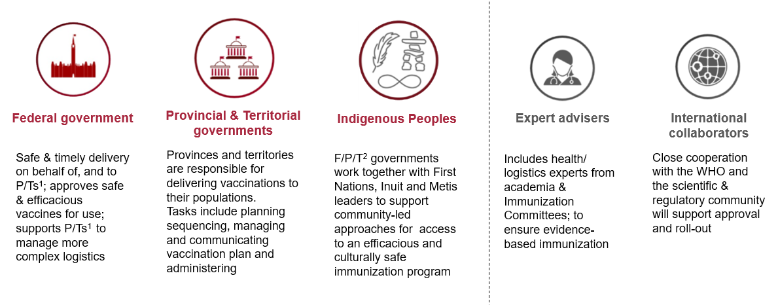
Canada’s Immunization Plan: Key Partners
Canada’s COVID-19 Response and Immunization Plan: Saving Lives and Livelihoods
1. Provinces/Territories; 2. Federal/Provincial/Territorial

Slide 17
NACI: Identification of Priority Groups for Immunization
Canada’s COVID-19 Response and Immunization Plan: Saving Lives and Livelihoods

Slide 18
NACI’s Recommendation for Sequencing of Key Populations prioritized for COVID-19 Immunization
Canada’s COVID-19 Response and Immunization Plan: Saving Lives and Livelihoods

Slide 19
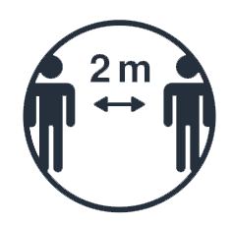
The Importance of Staying Vigilant
Canada’s COVID-19 Response and Immunization Plan: Saving Lives and Livelihoods
Implementation of Canada’s COVID-19 Immunization Plan is under way. Vaccinations will be available at no cost to everyone in Canada who wants one
Governments across Canada are committed to working together and to keeping Canadians informed throughout Canada’s COVID-19 immunization response. Addressing the threat of COVID-19 is a shared responsibility. We each have an essential part to play in saving lives and protecting Canadian livelihoods
Until extensive immunization is achieved, public health measures will continue to be essential to minimize the spread of COVID-19 in Canada and save lives

Slide 20
Canadian Dental Association (CDA) and COVID-19
Canada’s COVID-19 Response and Immunization Plan: Saving Lives and Livelihoods
The CDA has been working closely with government officials and public health experts since the onset of the COVID-19
The Canadian Dental Regulatory Authorities Federation has participated in the PHAC working group on non-traditional immunizers
the CDA has participated in the Health Canada Testing and Screening Exchange Forum on Task shifting
The CDA COVID-19 Response Team shares information and provides members with regular updates, options and recommendations for safely moving forward
CDA has prepared, and is regularly updating a ‘roadmap’ to assist dentists and their dental team members on how they can access federally financed support programs
The CDA is working to promote a safe clinical dental care environment for patients and providers

Slide 21
New Study: McGill Project
This study aims to understand the occupational risks of SARS-CoV-2 infection for people studying and working in dentistry, and will determine infection incidence rates among its target population
The research involves 12 researchers across 10 Canadian dental schools, and will take place from January to December 2021
The study will also include a vaccine surveillance component, which will investigate the target population’s immune response to vaccines and infection (including attention to variants of concern).
The findings will contribute knowledge towards improving the general understanding of risks of SARS-CoV-2 transmission for dentistry and dental hygiene students, faculty, and staff, and inform infection control protocols in these educational and clinical settings.
Canada’s COVID-19 Response and Immunization Plan: Saving Lives and Livelihoods

Slide 22
The Way Forward
Canada’s COVID-19 Response and Immunization Plan: Saving Lives and Livelihoods

Slide 23
By Working Together, We Can Move From Risk to Resilience
Canada’s COVID-19 Response and Immunization Plan: Saving Lives and Livelihoods
By itself, the health system cannot lead us to COVID-19 recovery
Cross-sectoral leadership is critical to maintain and focus on addressing health inequities
What we can continue to work on together:
Reducing stigma and discrimination
Data understanding and decision-making
Environmental sustainability
Economic security and employment conditions
Chief Public Health Officer of Canada's Report on the State of Public Health in Canada 2020

Slide 24
Call to Action: Be an Ambassador for COVID-19 Vaccination
Canada’s COVID-19 Response and Immunization Plan: Saving Lives and Livelihoods
Inform others: Help us share credible COVID-19 information on vaccines and public health with your communities (Bilingual / Multilingual toolkits available on our website).
Champion healthy practices: As vaccination rolls out, lead by example by continuing to follow good public health practices to protect against COVID-19 and encourage your community members to do the same.
Think local: Your local public health authority determines appropriate measures within your community so “think local” and follow local public health advice.

